Slide 1
ECE/CS 552: Pipelining
Boone Severson
Lecture notes based in part on slides created by Joshua San Miguel, Mikko Lipasti, Mark Hill and John Shen

Slide 2
Multi-Cycle Processor

Slide 3
Multi-Cycle Processor
Multi-cycle implementation:
  Clock period = max{T_{F}, T_{D}, T_{X}, T_{M}, T_{W}} ≥ T/5
Cycle Instns | 1 | 2 | 3 | 4 | 5 | 6 | 7 | 8 | 9 | 10 | 11 | 12 | 13 | 14 | 15
lw $t0, 0($t1) | F | D | X | M | W
beq $t2, t3, DEST |  |  |  |  |  | F | D | X | M
sw $t4, 0($t5) |  |  |  |  |  |  |  |  |  | F | D | X | M

Slide 4
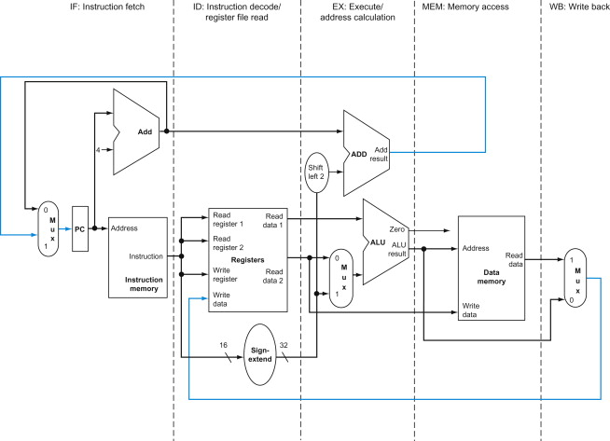
Pipelining
I1
I2
I3
I4
I5
I1
I2
I3
I4
I1
I2
I3
I1
I2
I1
I2
I3
I4
I5
I6
I3
I7
I4
I5
I6
I7
I8
I1
I2
I3
I4
I5
I6

Slide 5
Pipelining
Multi-cycle implementation:
  Clock period = max{T_{F}, T_{D}, T_{X}, T_{M}, T_{W}} ≥ T/5
Cycle Instns | 1 | 2 | 3 | 4 | 5 | 6 | 7 | 8 | 9 | 10 | 11 | 12 | 13 | 14 | 15
lw $t0, 0($t1) | F | D | X | M | W
beq $t2, t3, DEST |  |  |  |  |  | F | D | X | M
sw $t4, 0($t5) |  |  |  |  |  |  |  |  |  | F | D | X | M
Pipelining:
  IPC of single-cycle implementation
  Clock period of multi-cycle implementation
Cycle Instns | 1 | 2 | 3 | 4 | 5 | 6 | 7 | 8 | 9 | 10 | 11 | 12 | 13 | 14 | 15
lw $t0, 0($t1) | F | D | X | M | W
beq $t2, t3, DEST |  | F | D | X | M | W
sw $t4, 0($t5) |  |  | F | D | X | M | W

Slide 6
Pipelining

Slide 7
Exercise
Can RegWrite come from EX/MEM instead?

Slide 8
Exercise
Can RegWrite come from EX/MEM instead?

Slide 9
Exercise
Can RegWrite come from EX/MEM instead? No

Slide 10
Exercise
Can RegDst mux come after EX/MEM instead?

Slide 11
Exercise
Can RegDst mux come after EX/MEM instead?

Slide 12
Exercise
Can RegDst mux come after EX/MEM instead? Yes

